Slide 1
Stat. Lab Week 1
Y. Braun M. Joffe
309914646 324680461

Slide 2
Intro:
In this exercise we familiarized ourselves with some of python’s most important libraries, specifically pandas, os and matplotlib.
We performed some analyses on the results of the September 2019 elections in Israel.
Among these we found the city with the largest number of disqualified votes.
We wrote a function that compares voting patterns in 2 given cities.
We implemented a function that calculates the ‘distances’ (as per the multinomial distribution described in the exercise pdf) between each city/town and the whole country.

Slide 3
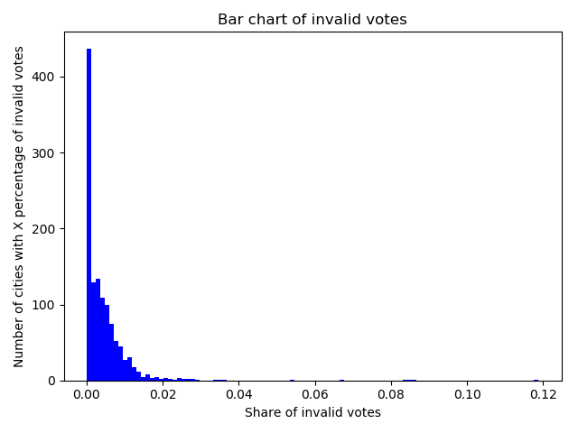
Invalid Votes
As can be seen, a significant number of towns and cities had very low (0 or close to 0) disqualified votes.
The vast majority of towns and cities had less than 2% of the total votes disqualified.
The city/town with the largest percentage of disqualified votes was: ברקת with 11.884% of their total votes disqualified.

Slide 4
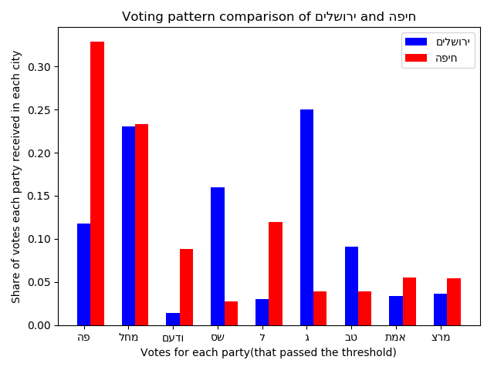
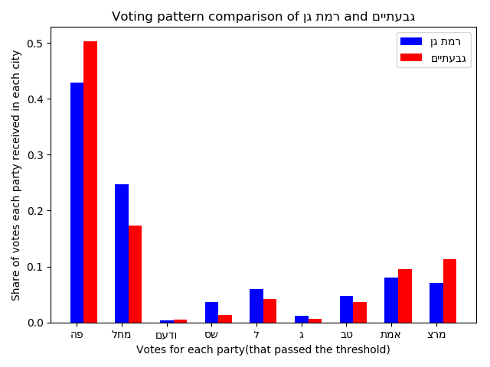
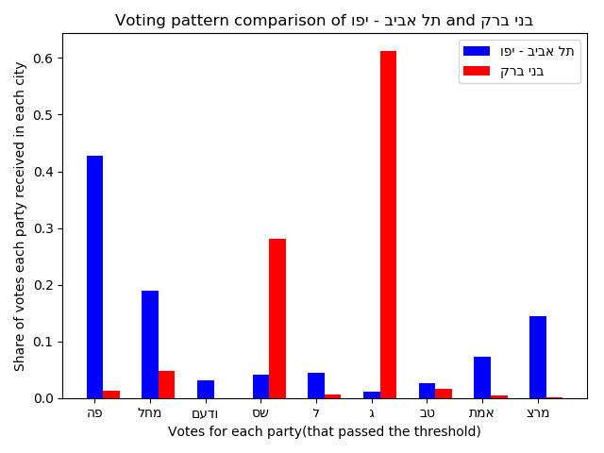
City Comparison
Jerusalem vs. Haifa
Ramat Gan vs. Givatayim
Tel Aviv vs. Bnei Brak

Slide 5
City Comparison
The 3 pairs of cities we chose to compare are: Jerusalem vs. Haifa, Ramat Gan vs. Givatayim and Tel Aviv vs. Bnei Brak.
In Jerusalem vs. Haifa, the 3 ‘religious’ parties ('ג', 'שס', 'טב') received significantly higher vote shares in Jerusalem than in Haifa, with 'ג' receiving over 25% of the total vote in Jerusalem (compared to less than 5% in Haifa), while in Haifa, two of the more secular parties ('פה', 'ל') received significantly higher vote shares than in Jerusalem, with 'פה' receiving well over 30% of the total vote in Haifa (compared to about 12% in Jerusalem).
In Ramat Gan vs. Givatayim, we found that there were no significant differences in the voting patterns, with no party receiving more than 7.5% more votes in one city vs. the other.
In Tel Aviv vs. Bnei Brak, the two parties that tend to be favored by the ultra-orthodox population (which constitute an absolute majority in Bnei Brak) together garnered over 89% of the votes in Bnei Brak ('ג' with over 61% and 'שס' with just over 28%), while no other party received even 5% of the vote. In Tel Aviv, the top 5 parties in terms of vote share were all secular parties ('פה', 'מחל', 'מרצ', 'אמת' and 'ל'), constituting nearly 88% of the vote share, while 'ג' and 'שס' together received just over 5% of the total vote.
Notes:
We chose these because we to see the differences between cities that we believed would be have very similar voting patterns (Ramat Gan and Givatayim), cities that we believed would have very different voting patterns (Tel Aviv and Bnei Brak) and cities whose voting patterns we believed wouldn’t be very similar yet not different to the extreme (Jerusalem and Haifa).
Jerusalem vs. Haifa:
We expected, based on demographics and socio-economic status, that the voting preferences in Jerusalem would tend to favor conservative and religious parties, while the voting preferences in Haifa would tend to favor more liberal and secular parties.
One thing that struck us as interesting when analyzing the voting patterns in these two cities was that the percentages of votes for 'מחל', a secular right-wing party, were about the same in both cities, at about 23%.
Another was that both Jerusalem and Haifa are known for being ‘mixed’ cities, i.e. with large Jewish and Arab populations, however the share of votes for 'ודעם', the only primarily Arab party, was very different, with this party receiving almost 9% of the vote in Haifa, compared to less than 1.5% in Jerusalem.
Ramat Gan vs. Givatayim
We chose to analyze the voting patterns in Ramat Gan and Givatayim precisely because we expected the patterns to be relatively similar. The cities are located right next to each other and the demographics and socio-economic levels of their inhabitants are relatively similar.
The largest differences were for the two parties which received the most votes, both in these two cities as well as countrywide, with 'פה' receiving about a 7.5% higher vote share in Givatayim than in Ramat Gan, while 'מחל' received about a 7.5% higher vote share in Ramat Gan than in Givatayim.
Tel Aviv vs. Bnei Brak:
We chose to analyze the voting patterns in Tel Aviv vs. Bnei Brak precisely because we expected them to be very different, since Tel Aviv and Bnei Brak are very different with respect to demographics, religious tendencies and socio-economic status.

Slide 6
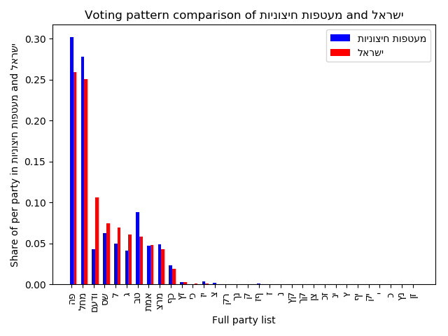
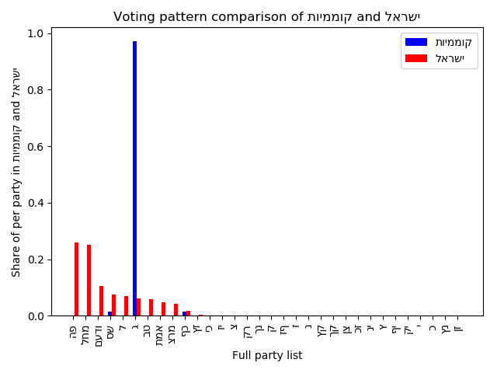
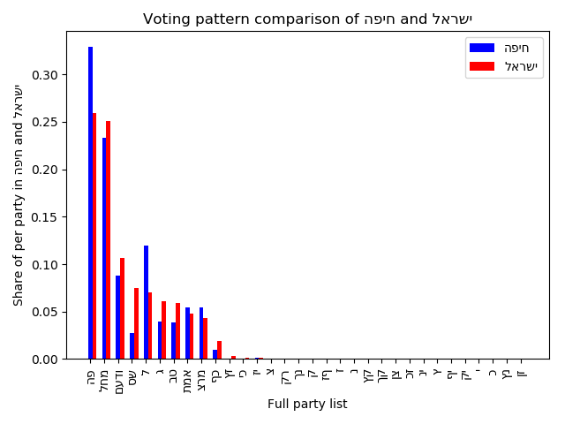
Distances
Max
Min

Slide 7
Distances:
For these graphs we took all of the parties that ran in the election, even those that didn’t pass the threshold of 3.25% to win seats in the Knesset.
For the Min Distance graph (the closest city/town after calculating the multinomial distribution using the formula provided in the exercise description), we found that the results for 'מעטפות חיצוניות' most resembled the countrywide results, with a distance ‘score’ of about 0.008.
However, since 'מעטפות חיצוניות' is not actually a city, we also found the city with the second smallest distance ‘score’, which was 'חיפה' with a ‘score’ of about 0.011.
For the Max Distance graph (the furthest city/town), we found that 'קוממיות’ was the town whose voting pattern least resembled that of the country as a whole, with a distance ‘score’ of about 0.987.

